Slide 1
10. Linguistic Linked Open Data
John P. McCrae
CT5166

Slide 2
Course structure
9th Sep | Introduction to Knowledge Graphs | 21st Oct | Inductive reasoning
16th Sep | Models for Knowledge Graphs | 28th Oct | KG Creation (no lab on Monday)
23rd Sep | Querying and Serialization | 4th Nov | KG Alignment
30th Sep | Schemas | 11th Nov | Publishing and Linked Open Data
7th Oct | Deductive reasoning | 18th Nov | Linguistic Linked Open Data
14th Oct | No Lecture | 25th Nov | Enterprise Knowledge Graphs

Slide 3
Knowledge Graphs for Linguistics

Slide 4
The promise of linked open data for NLP
Representation and Modelling
Structural Interoperability
Federation
Ecosystem
Expressivity
Conceptual Interoperability
Dynamic Import
Towards open data for linguistics: Lexical Linked Data. Christian Chiarcos, John McCrae, Philipp Cimiano and Christiane Fellbaum, In: New Trends of Research in Ontologies and Lexical Resources, pp 7-25, (2013).

Slide 5


Representation and Modelling
Claim: Lexical-semantic resources are best described as labeled directed graphs such as RDF.

Slide 6
Structural Interoperability
Claim: Using a common data model eases the integration of different resources

Slide 7
Federation
Claim: In contrast to traditional methods, where it may be difficult to query across even multiple parts of the same resource, linked data allows for federated querying across multiple, distributed databases maintained by different data providers
In theory, but still uncommon

Slide 8
Ecosystem
Claim: Linked data is supported by a community of developers in other fields beyond linguistics, and the ability to build on existing tools and systems is clearly an advantage.
There are some great tools but also many tools that don’t support RDF

Slide 9

Expressivity
Claim: Semantic Web languages (OWL in particular) support the definition of axioms that allow to constrain the usage of the vocabulary, thus introducing the possibility of checking a lexicon or annotated corpus for consistency.

Slide 10


Conceptual Interoperability
Claim: The use of globally unique identifiers for concepts or categories can be used to define the vocabulary that we use and these URIs can be used by many parties who have the same interpretation of the concept
Some projects successful, some not

Slide 11
Dynamic Import
Claim: URIs can be used to refer to external resources such that one can thus import other linguistic resources “dynamically”. By using URIs to point to external content, the URIs can be resolved when needed.
Yes, but also many resources are no longer available

Slide 12
Discussion
How do you think knowledge graphs could be used for linguistics or NLP?

Slide 13
Interoperability in Linguistics

Slide 14
Outline
Knowledge Graphs for Linguistics
Interoperability
Models of Linguistic Linked Open Data
OntoLex-Lemon Model
Conclusion

Slide 15
Why reuse identifiers?
Data interoperability
Queries work over multiple datasets
Semantic definitions allow alignments to be reasoned
(Often) the creators of the URIs have good idea about how data should be structured
“Not Invented Here” Syndrome

Slide 16
Challenges of Interoperability
Differences in Granularity
Susanne Penn
The AT DT
Fulton NP1s NNP
County NNL1cb NNP
Grand JJ NNP
Jury NN1c NNP
said VVDv VBD
Friday NPD1 NNP
Linguistic Differences

Slide 17




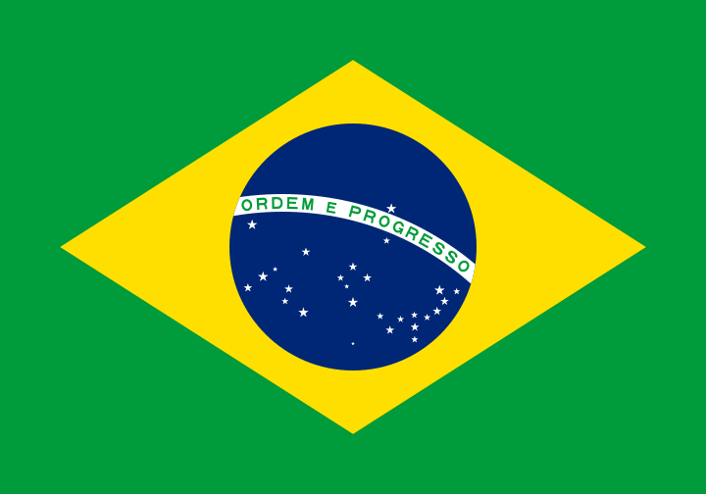
Example: Language Codes
en
fr
de
th
Problem: 7,000+ languages and more dialects, but only 26²=676 codes
br = Breton
br?

Slide 18



Example: ISO Language Codes
pms
Piedmontese
ang
Anglo-Saxon
fr-CA
Québécois
3-Letter codes with region cover minority & historical languages, right?

Slide 19
Variability
How to tag this talk?
en?
en-Latn? (As it is not written in Cyrillic)
en-IE or en-371 (As it is presented in Ireland)
en-GB or en-826 (As the presenter uses British English)
en-Latn-GB?
Region subtags are used to indicate linguistic variations associated with or appropriate to a specific country, territory, or region. Typically, a region subtag is used to indicate variations such as regional dialects or usage, or region-specific spelling conventions. It can also be used to indicate that content is expressed in a way that is appropriate for use throughout a region, for instance, Spanish content tailored to be useful throughout Latin America.
-- RFC 5646

Slide 20
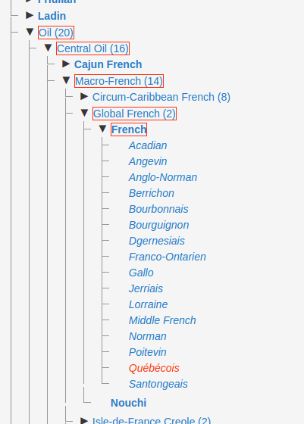
Glottolog
Identifies languoids (language varieties)
Uses URLs
http://glottolog.org/resource/languoid/id/queb1247
More information can be found by following the link

Slide 21
ISOcat
Effort to standardize linguistic vocabulary from ISO Technical Committee
Standardized “Data Categories” in a “Registry”
Discontinued in December 2014

Slide 22
Problems with ISOcat
According to Schuurman et al.
Too easy to get a login
“Out-of-control”
Entries were copies of other entries
“People sometimes copied an entry, just in order to make sure the original owner would not change the entry without them knowing it”
Complexity - Too many obligatory and overly technical fields

Slide 23
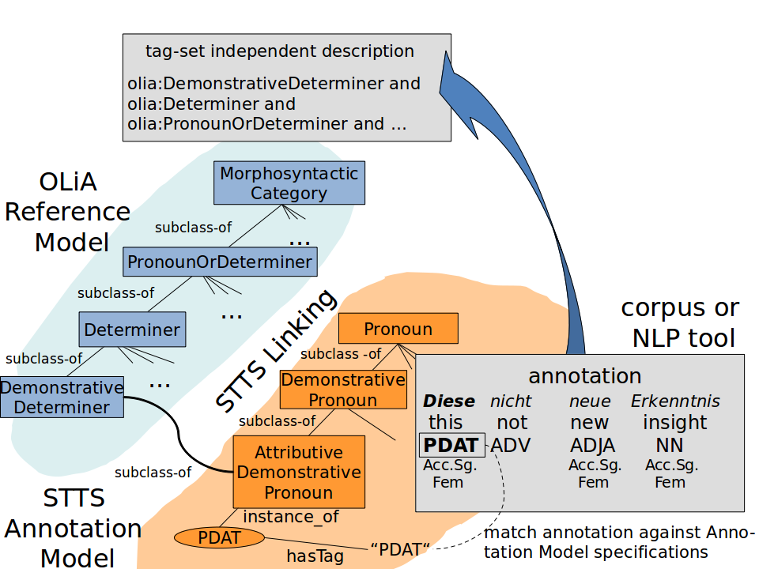
OLiA
Ontologies of Linguistic Annotation
Modular architecture for describing annotation schemes:
Reference Model: Common terminology (similar to LexInfo)
Annotation Model: Describes a particular annotation scheme
Linking Model: Describes the linking between the reference and annotation

Slide 24
Models for linguistic knowledge graphs

Slide 25
LLOD models
Corpora
NLP Interchange Format (NIF)
Open Annotation
Lexicons
Lexicon Model for Ontologies (lemon)/OntoLex
Other
Marl model for representing “Opinions on the Web“ (sentiment)
OLiA for linguistic interoperability

Slide 26
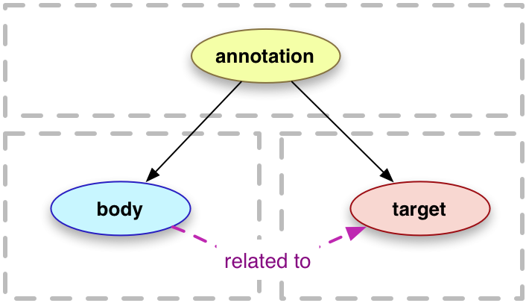
Open Annotation
Stand-off annotation
Annotation is in another file (compare to in-line annotation like HTML)
Target can be HTML, PDF, XML, etc.
Plain text
Character offsets, e.g., #char=3,7
SVG
Video, Audio
Time offsets

Slide 27
Open Annotation
Stand-off annotation
Annotation is in another file (compare to in-line annotation like HTML)
Target can be HTML, PDF, XML, etc.
Plain text
Character offsets, e.g., #char=3,7

Slide 28
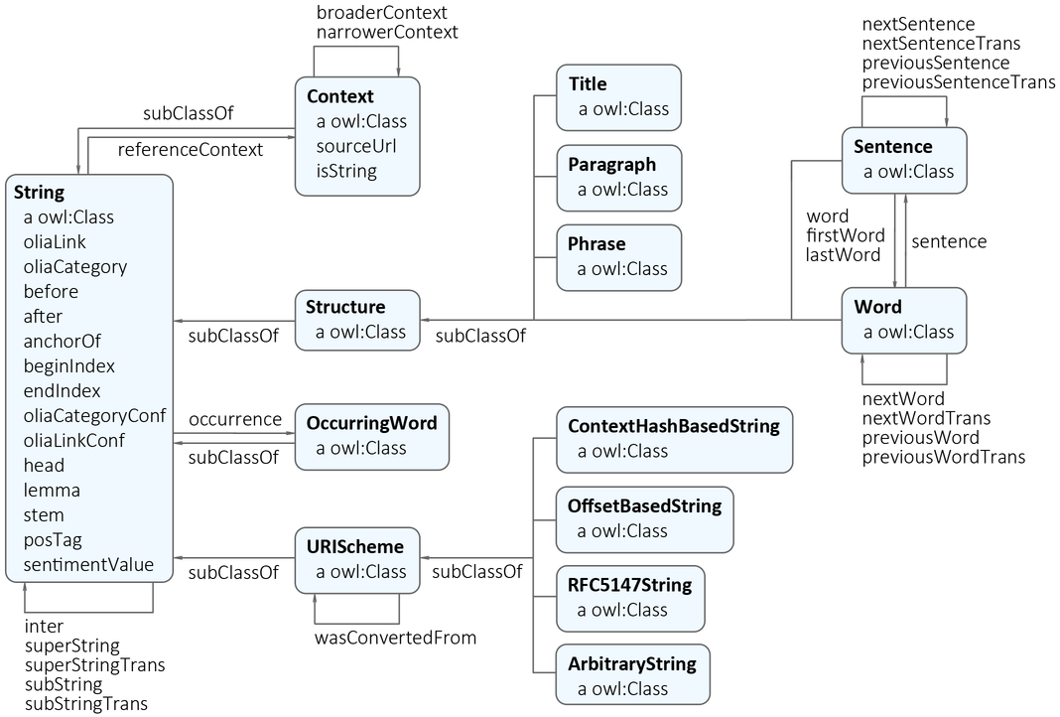
NIF - NLP Interchange Format

Slide 29
OntoLex- Lemon Model

Slide 30
Outline
Knowledge Graphs for Linguistics
Interoperability
Models of Linguistic Linked Open Data
OntoLex-Lemon Model
Conclusion

Slide 31
OntoLex-Lemon
https://www.w3.org/2016/05/ontolex/
Primary model for representing lexical content (information you would find in a dictionary) with ontology models such as OWL

Slide 32

Ontologies
http://www.example.com/foo/ID1234
“Language”@en
“Teanga”@ga
...Cuairt Liteartha do Theangacha Mionlaigh san Eoraip...

Slide 33
Ontologies
Ontology or the science (logia) of being (onto) is a branch of philosophy, and more specifically, metaphysics (which studies the fundamental nature of reality, i.e., the things that exist).
In computer science: classifying and modelling entities according to their fundamental properties, using interrelationships and hierarchies, often in a particular domain (e.g., biomedical).

Slide 34
Linked Data on the Web
“Edema”
http://dbpedia.org/resource/Edema
http://de.dbpedia.org/resource/Ödem
umls:C0013604
mesh:D00487
icd10:R60.9

Slide 35
Linked Data with Language
“Edemata”
http://dbpedia.org/resource/Edema
http://de.dbpedia.org/resource/Ödem
“Edema”
mesh:D00487
icd10:R60.9
umls:C0013604
“Dropsy”

Slide 36
Lexical Entries
“Edemata”
dbpedia:Edema
EDEMA
mesh:D00487
“Edema”
icd10:R60.9
“Dropsy”
DROPSY
umls:C0013604

Slide 37
What is a lexical entry?
A lexical entry represents a unit of analysis of the lexicon that consists of a set of forms that are grammatically related and a set of base meanings that are associated with these forms. Thus, a lexical entry is a word, multiword expression or affix with a single part-of-speech, morphological pattern, etymology and set of senses.

Slide 38
Kahoot Quiz

Slide 39
Are these different lexical entries?
No, these are two forms of the same verb
work vs works?
work vs worker?
work vs unwork?
work (noun) vs work (verb)?
lead (as in lead windows) vs lead (as in project lead)?
bank (as in Bank of Ireland) vs bank (as in river bank)?
Yes, different part of speech, different lemma
Yes, same part of speech, different lemma
Yes, different part of speech
Yes, different pronunciation
Actually, Yes! 1st is from Italian “banca” 2nd from Old English “hōbanca”

Slide 40
Forms
“Edemata”
“Edema”
number=plural
number=singular
EDEMA

Slide 41
Modelling example
<http://www.example.com/work> a ontolex:LexicalEntry ;
ontolex:canonicalForm [ ontolex:writtenRep “work”@en ] ;
ontolex:otherForm [ ontolex:writtenRep “works”@en ] .
<http://www.example.com/worker> a ontolex:LexicalEntry ;
ontolex:canonicalForm [ ontolex:writtenRep “worker”@en ] .

Slide 42
Senses
EDEMA
DROPSY
dating=old
dbpedia:Edema
dbpedia:Fish_Dropsy

Slide 43
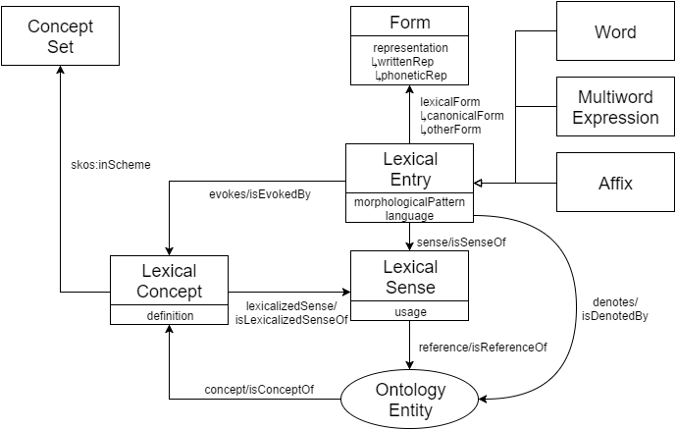
OntoLex- Lemon Model

Slide 44
Simple Entries
OntoLex Namespace
@prefix ontolex: <http://www.w3.org/ns/lemon/ontolex#> .
@prefix skos: <http://www.w3.org/2004/02/skos/core#> .
<#cat> a ontolex:Word ;
ontolex:canonicalForm [
ontolex:writtenRep “cat”@en ] ;
ontolex:denotes [
skos:definition “A four-legged, furry animal”@en ] .
Lemma
Sense

Slide 45
Simple Entries with Grammatical Info
@prefix ontolex: <http://www.w3.org/ns/lemon/ontolex#> .
@prefix skos: <http://www.w3.org/2004/02/skos/core#> .
@prefix lexinfo: <http://www.lexinfo.net/ontology/2.0/lexinfo#> .
<#cat> a ontolex:Word ;
lexinfo:partOfSpeech lexinfo:noun
ontolex:canonicalForm [
ontolex:writtenRep “cat”@en ;
lexinfo:number lexinfo:singular ] ;
ontolex:otherForm [
ontolex:writtenRep “cats”@en ;
lexinfo:number lexinfo:plural ] ;
ontolex:denotes [
skos:definition “A four-legged, furry animal”@en ] .
LexInfo Ontology
Part of Speech
Inflected Form

Slide 46
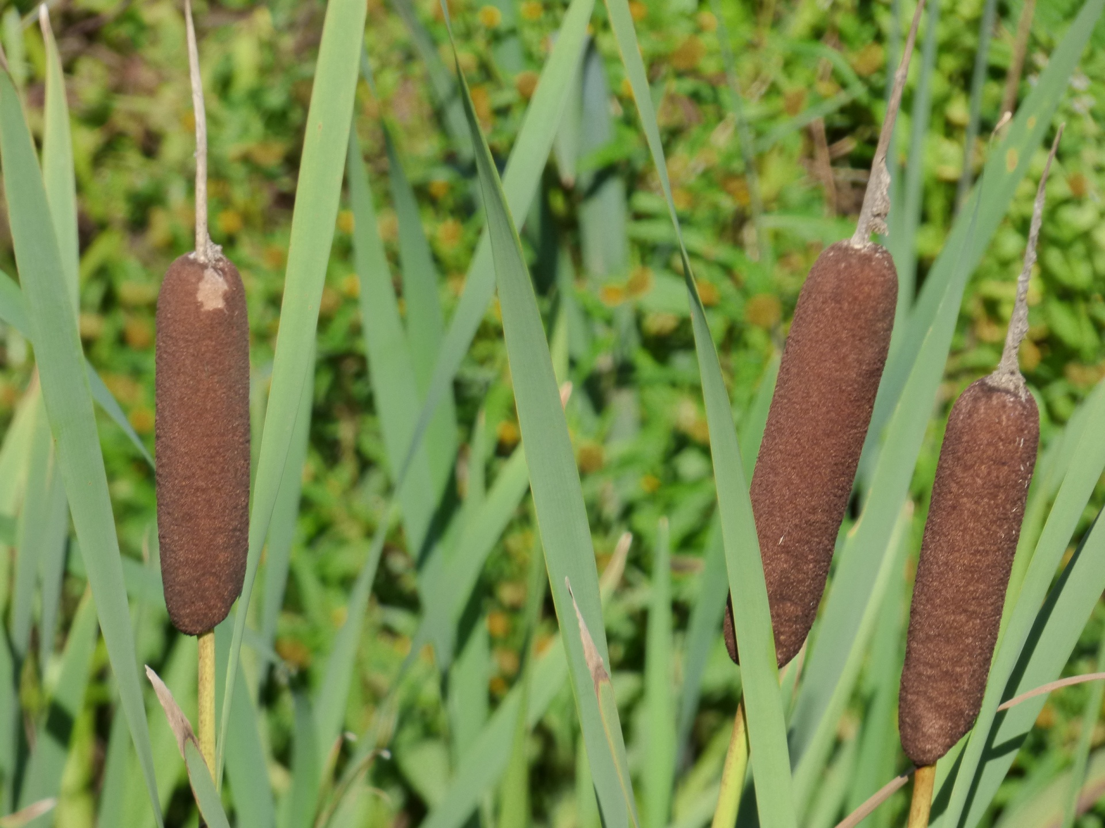
Lexical Senses
@prefix ontolex: <http://www.w3.org/ns/lemon/ontolex#> .
@prefix dbpedia: <http://dbpedia.org/resource/> .
@prefix dbo: <http://dbpedia.org/ontology/> .
<#bulrush> a ontolex:Word ;
ontolex:sense [
ontolex:reference dbpedia:Typha ;
ontolex:usage [ rdf:value “British English” ] ] ;
ontolex:denotes dbpedia:Typha .
<#cattail> a ontolex:Word ;
ontolex:sense [
ontolex:reference dbpedia:Typha ;
ontolex:usage [ rdf:value “American English” ] ] ;
ontolex:denotes dbpedia:Typha .
sense ⚬ reference
=
denotes
Restriction on Lexical Sense

Slide 47
Conclusion

Slide 48
Conclusion
Linked data can help NLP in a number of ways
Representation
Structural Interoperability
Federation
Ecosystem
Managing Change
Interoperability

Slide 49
Conclusion
Common flexible models can help interoperability
For example, OntoLex-Lemon
Represent lexical information in terms of
Lexical Entries
Forms
Senses
Ontological Entities

